Slide 1
AI-Driven analysis of company registrations

Slide 2
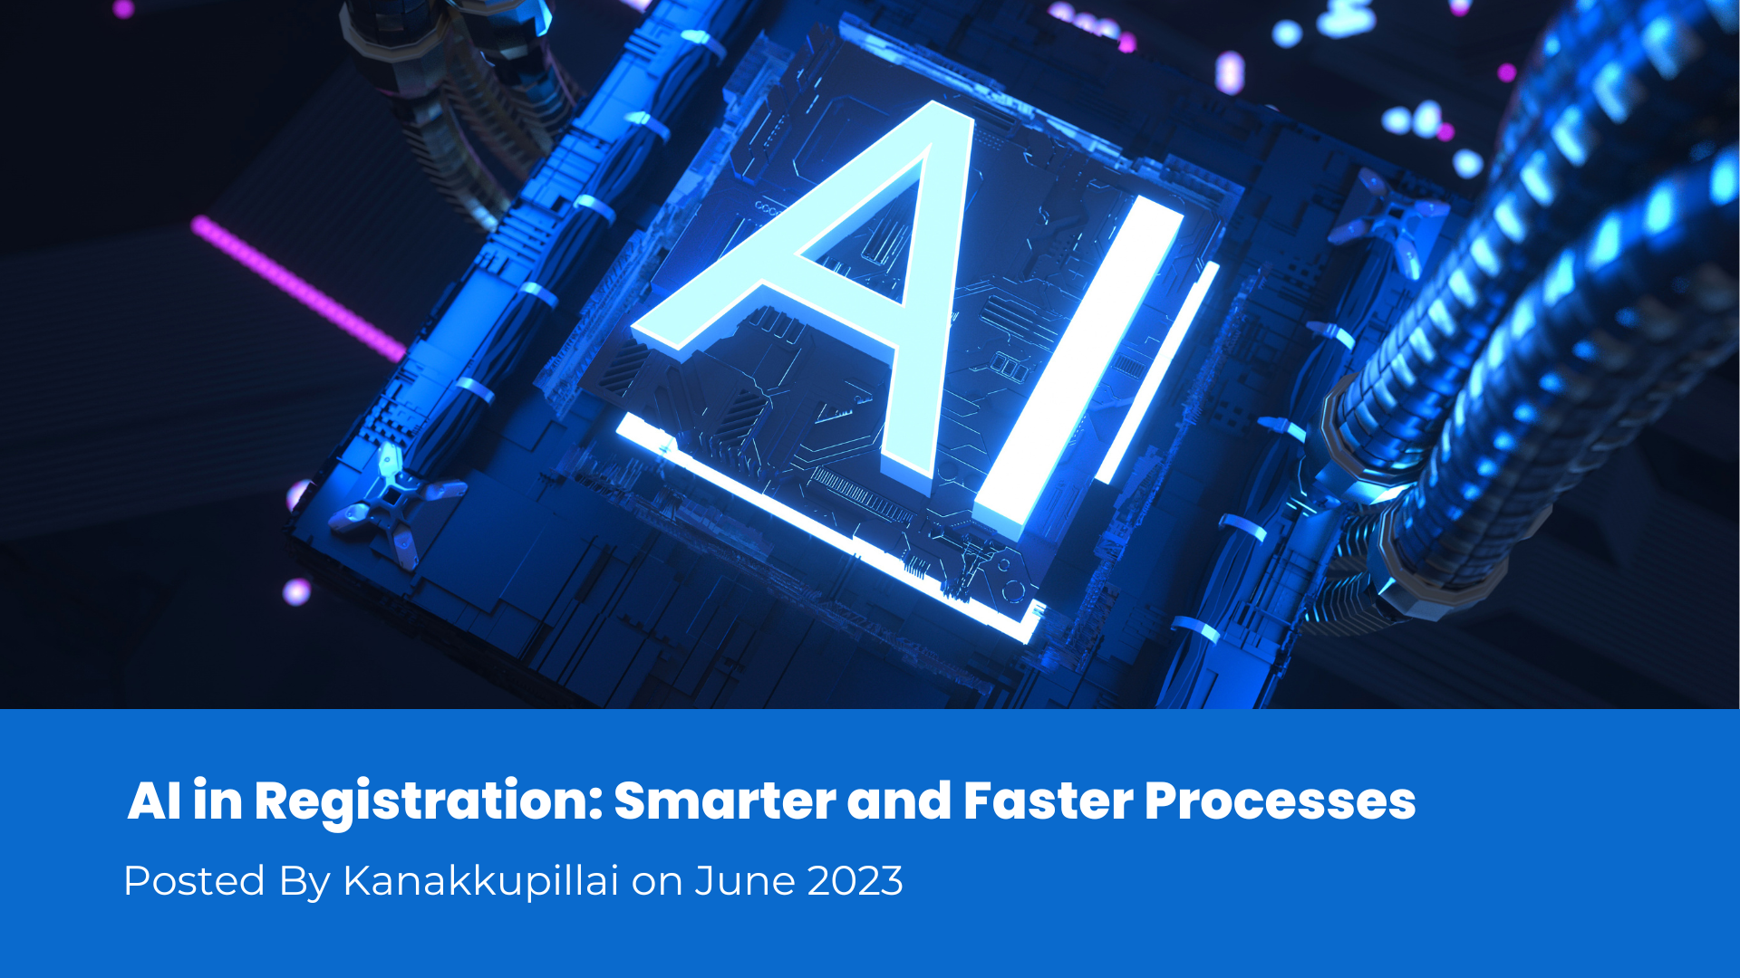
AI-driven analysis of company registrations involves using artificial intelligence (AI) techniques to extract meaningful insights and patterns from the vast amount of data available in company registration records. This can be valuable for various purposes, including market research, risk assessment, compliance monitoring, and fraud detection. Here's an overview of how AI can be applied to analyze company registrations:

Slide 3
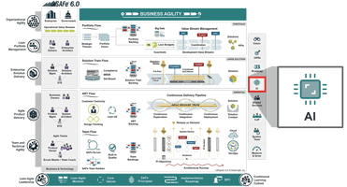
Data Extraction:
Natural Language Processing (NLP): NLP can be used to extract information from unstructured textual data in registration documents. This includes company names, addresses, directors' names, and other relevant details.
OCR (Optical Character Recognition): For scanned documents, OCR technology helps convert images of text into machine-readable text, facilitating data extraction.

Slide 4
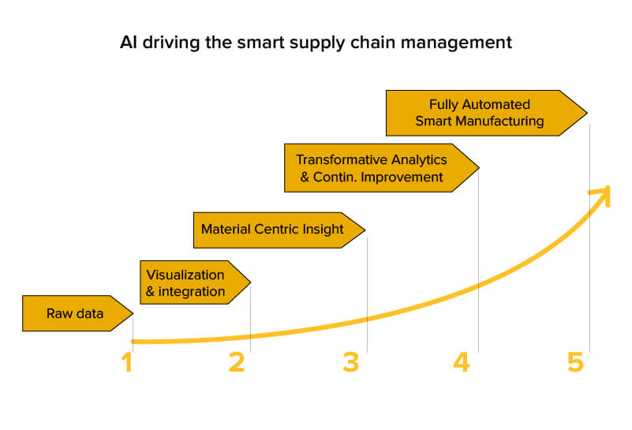
Entity Resolution:
Matching and Linking: AI algorithms can identify and link related information across multiple datasets. This helps in resolving discrepancies and creating a comprehensive view of a company's information.
Classification and Categorization:
Machine Learning (ML) Models: ML models can be trained to categorize companies based on industry, size, or other relevant parameters. This aids in segmentation and targeted analysis.

Slide 5

Anomaly Detection:
Pattern Recognition: AI algorithms can detect unusual patterns or outliers in company registration data, which may indicate potential fraud or irregularities.
Behavior Analysis: Analyzing historical data and identifying deviations from typical registration patterns can help in flagging suspicious activities.
Predictive Analytics:
Time Series Analysis: By studying historical registration trends, AI can predict future registration patterns, providing insights into market dynamics.
Credit Risk Assessment: AI models can assess the creditworthiness of companies based on various factors derived from registration data.

Slide 6
Thank you

